Slide 1

HIVE

Slide 2
CONTENTS
Data Types
Internal/Managed Table Vs External table
Partitions and Buckets

Slide 3
Data Types
There are different data types in Hive, which are involved in the table creation. All the data types in Hive are classified into four types, given as follows:
Column Types
Literals
Null Values
Complex Types

Slide 4
Column Types
Column type are used as column data types of Hive. They are as follows:
Integral Types
Integer type data can be specified using integral data types, INT.
When the data range exceeds the range of INT, you need to use BIGINT and if the data range is smaller than the INT, you use SMALLINT.
TINYINT is smaller than SMALLINT.

Slide 5
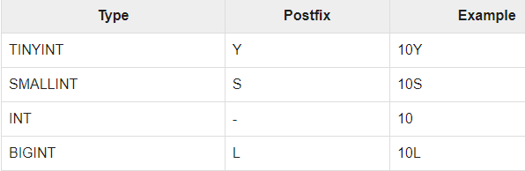
The following table depicts various INT data types:

Slide 6
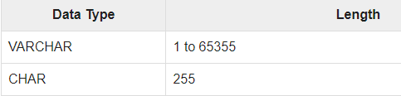
String Types
String type data types can be specified using single quotes (' ') or double quotes (" ").
It contains two data types: VARCHAR and CHAR. Hive follows C-types escape characters.
The following table depicts various CHAR data types:

Slide 7
Timestamp
It supports traditional UNIX timestamp with optional nanosecond precision.
It supports java.sql.
Timestamp format “YYYY-MM-DD HH:MM:SS.fffffffff” and format “yyyy-mm-dd hh:mm:ss.ffffffffff”.
Dates
DATE values are described in year/month/day format in the form {{YYYY-MM-DD}}.

Slide 8

Decimals
The DECIMAL type in Hive is as same as Big Decimal format of Java.
It is used for representing immutable arbitrary precision.
The syntax and example is as follows:

Slide 9
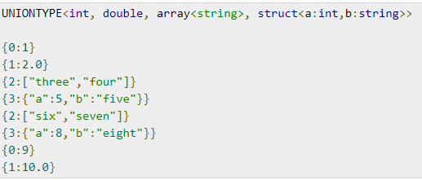
Union Types
Union is a collection of heterogeneous data types.
You can create an instance using create union.
The syntax and example is as follows:

Slide 10
Literals
The following literals are used in Hive:
Floating Point Type
Floating point types are nothing but numbers with decimal points.
Generally, this type of data is composed of DOUBLE data type.
Decimal Type
Decimal type data is nothing but floating point value with higher range than DOUBLE data type.
The range of decimal type is approximately -10-308 to 10308.

Slide 11
Null Values
Complex Types
Missing values are represented by the special value NULL.
The Hive complex data types are as follows:

Slide 12
Arrays
Arrays in Hive are used the same way they are used in Java.
Maps
Maps in Hive are similar to Java Maps.

Slide 13
Structs
Structs in Hive is similar to using complex data with comment.

Slide 14
Internal and External table - Introduction
Hive can be used to manage structured data on the top of Hadoop.
The data is stored in the form of a table inside a database.
Hive fundamentally knows two different types of tables:
Managed (Internal)
External

Slide 15
In Hive, the user is allowed to create Internal(Managed) as well as External tables to manage and store data in a database.
Both Internal and External table has their own use case and can be used as per the requirement.
For example, External tables are preferred over internal tables when we want to use the data shared with other tools on Hadoop like apache pig.

Slide 16
Internal/Managed table
In general, whenever we create a table inside a database in the Hive by default it is an Internal table also called the managed table.
The reason Internal tables are managed because the Hive itself manages the metadata and data available inside the table.
All the databases internal tables created in the Hive are by default stored at /user/hive/warehouse directory on our HDFS.

Slide 17
We can check or override the default storage hub for the hive in the hive.metastore.warehouse.dir property.
When Internal tables(managed tables) are dropped all their metadata and table data got deleted permanently from our HDFS and can not be retrieved back.
The Managed tables are not of any use when there is a requirement to use data available outside the Hive and also used by some other Hadoop utility on our HDFS(Hadoop Distributed File System) and the External table came into the picture.

Slide 18
Key Points about Internal Tables
Hive takes the data file we load to the table to the /database-name/table-name inside our warehouse
Internal table supports TRUNCATE command
Internal tables also have ACID Support
Internal tables also support query result caching means it can store the result of the already executed hive query for subsequent query
Metadata and Table data both will be removed as soon as the table is dropped

Slide 19
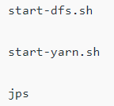

To perform the below operation make sure your hive is running. Below are the steps to launch a hive on your local system.
Step 1:
Start all your Hadoop Daemon.
Step 2:
Launch hive from terminal

Slide 20
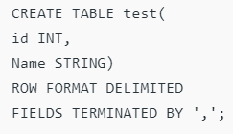
Now, we are all set to perform the quick demo.
Step 1:
Create The Table with a name test(the table will be created in the default database of the hive if not mentioned in any other database).
The table we create in the hive by default is an internal or managed table. With the above command, the internal table is successfully created.

Slide 21
Step 2:
Load data to the table test with the below command.
The data has been successfully loaded. Whenever we load any file data to the hive table Hive takes that file to the /database-name/table-name in the warehouse directory.

Slide 22


Step 3:
Let’s see whether the data is loaded into the table or not.
Step 4:
We can describe the table to see it is Internal or External

Slide 23


Step 5:
We can use TRUNCATE to delete the test table data since it is supported in Internal Hive tables.
Now as soon as the test table is truncated all table data will be removed from our warehouse since hive has ownership of internal tables.

Slide 24

Step 6:
Drop the table test(Now the metadata will also be deleted)

Slide 25
External table
External tables are an excellent way to manage data on the Hive since Hive does not have ownership of the data stored inside External tables.
In case, if the user drops the External tables then only the metadata of tables will be removed and the data will be safe.
The EXTERNAL keyword in the CREATE TABLE statement is used to create external tables in Hive.

Slide 26
We also have to mention the location of our HDFS from where it takes the data.
All the use cases where shareable data is available on HDFS so that Hive and other Hadoop components like Pig can also use the same data External tables are required.
The metadata for External tables is managed by Hive but these tables take data from other locations on our HDFS.

Slide 27
Key Points about External Tables
Hive won’t take data to our warehouse
The External table does not support the TRUNCATE command
No support for ACID transaction property
Doesn’t support query result caching
Only metadata will be removed when the External table is dropped

Slide 28

Let’s perform a small demo to understand the concept of External tables in Hive.
Step 1:
Create a directory with the name /TableData in HDFS
Step 2:
Now copy the data file you want to use with hive external table to this directory (In my case data.csv)

Slide 29
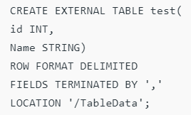
Step 3:
Now create an External table test with the EXTERNAL keyword as shown below(the table will be created in the default database of the hive if not mentioned in any other database)
The table test created with the EXTERNAL keyword will now take the data from the directory we have mentioned in the LOCATION attribute.

Slide 30

Step 4:
Let’s perform the select query on the external table test we have created.
It is possible because EXTERNAL tables are designed in such a way that they take data from the mentioned location. the location is /TableData in our case and we have a data.csv file inside it so Hive external table will automatically take data from this location.

Slide 31


Step 5:
Since the data is available outside of our warehouse and Hive does not have ownership of it so TRUNCATE is not possible with External tables.
Step 6:
Also if we drop this external table then only the table metadata will be removed but not the actual data stored at /TableData on our HDFS.

Slide 32

Hive Partitioning and Bucketing
Apache Hive is an open source data warehouse system used for querying and analyzing large datasets.
Data in Apache Hive can be categorized into Table, Partition, and Bucket.
The table in Hive is logically made up of the data being stored.
It is of two type such as an internal table and external table. Let us now discuss the Partitioning and Bucketing in Hive in detail.

Slide 33
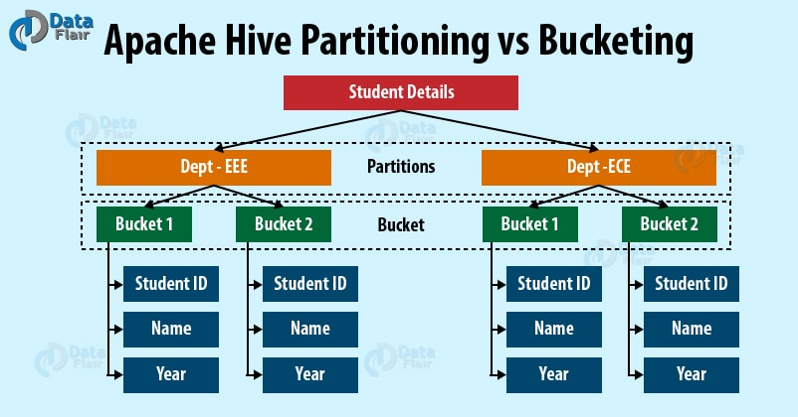

Slide 34
Partitioning
Apache Hive organizes tables into partitions for grouping same type of data together based on a column or partition key.
Each table in the hive can have one or more partition keys to identify a particular partition.
Using partition we can make it faster to do queries on slices of the data.
Bucketing
In Hive Tables or partition are subdivided into buckets based on the hash function of a column in the table to give extra structure to the data that may be used for more efficient queries.

Slide 35
Comparison between Hive Partitioning vs Bucketing
i. Partitioning and Bucketing Commands in Hive
a) Partitioning
The Hive command for Partitioning is:
[php]CREATE TABLE table_name (column1 data_type, column2 data_type) PARTITIONED BY (partition1 data_type, partition2 data_type,….);[/php]

Slide 36
b) Bucketing
The Hive command for Bucketing is:
[php]CREATE TABLE table_name PARTITIONED BY (partition1 data_type, partition2 data_type,….) CLUSTERED BY (column_name1, column_name2, …) SORTED BY (column_name [ASC|DESC], …)] INTO num_buckets BUCKETS;[/php]

Slide 37
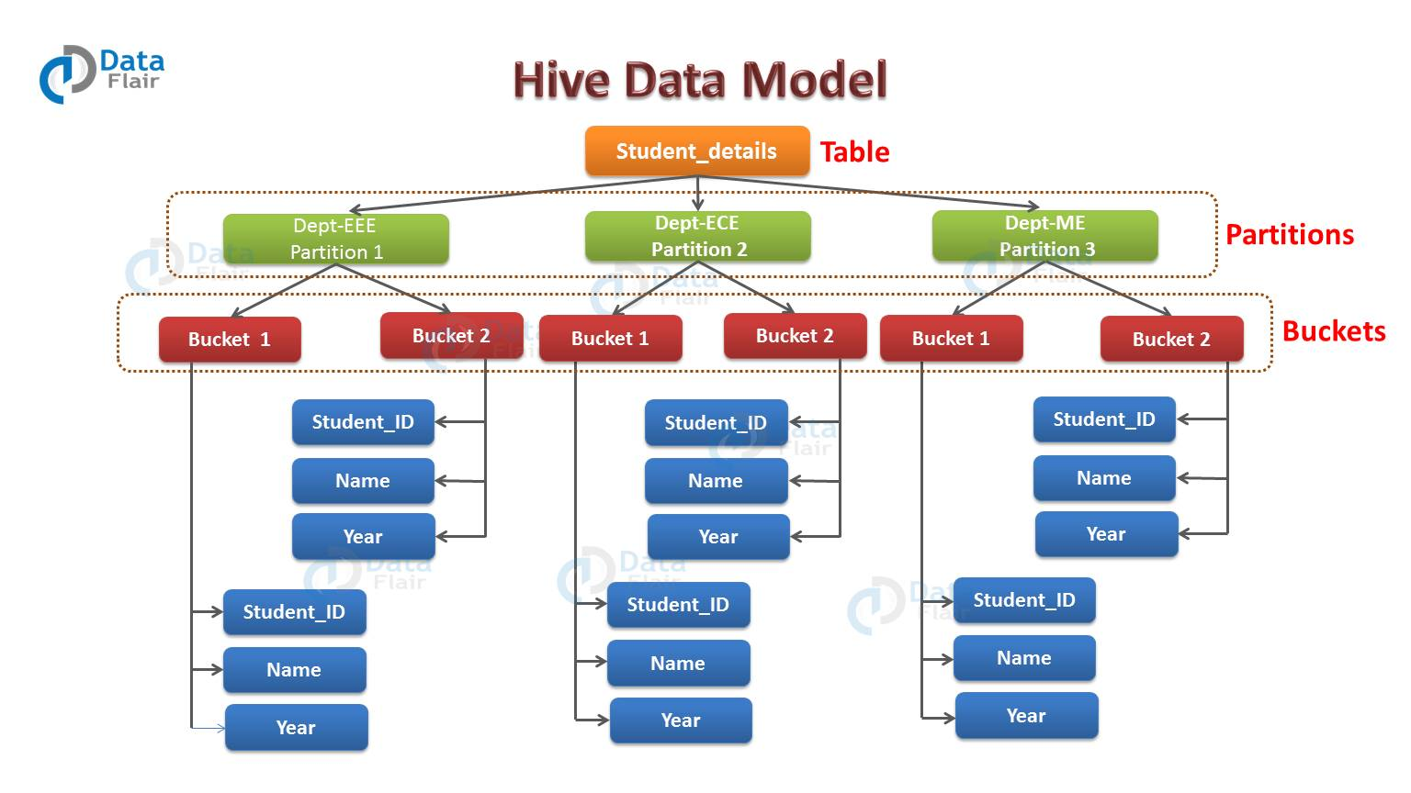
ii. Apache Hive Partitioning and Bucketing Example

Slide 38
a) Hive Partitioning Example
For example, we have a table employee_details containing the employee information of some company like employee_id, name, department, year, etc. Now, if we want to perform partitioning on the basis of department column.
Then the information of all the employees belonging to a particular department will be stored together in that very partition. Physically, a partition in Hive is nothing but just a sub-directory in the table directory.
For example, we have data for three departments in our employee_details table – Technical, Marketing and Sales.

Slide 39
For each department we will have all the data regarding that very department residing in a separate sub – directory under the table directory.
So for example, all the employee data regarding Technical departments will be stored in user/hive/warehouse/employee_details/dept.=Technical.
So, the queries regarding Technical employee would only have to look through the data present in the Technical partition.
Therefore from above example, we can conclude that partitioning is very useful. It reduces the query latency by scanning only relevant partitioned data instead of the whole data set.

Slide 40
b) Hive Bucketing Example
Hence, from the above diagram, we can see that how each partition is bucketed into 2 buckets.
Therefore each partition, says Technical, will have two files where each of them will be storing the Technical employee’s data.
iii. Advantages and Disadvantages of Hive Partitioning & Bucketing
Let us now discuss the pros and cons of Hive partitioning and Bucketing one by one-

Slide 41
a) Pros and Cons of Hive Partitioning
Pros:
It distributes execution load horizontally.
In partition faster execution of queries with the low volume of data takes place. For example, search population from Vatican City returns very fast instead of searching entire world population.

Slide 42
Cons:
There is the possibility of too many small partition creations- too many directories.
Partition is effective for low volume data. But there some queries like group by on high volume of data take a long time to execute.
For example, grouping population of China will take a long time as compared to a grouping of the population in Vatican City.
There is no need for searching entire table column for a single record.

Slide 43
b) Pros and Cons of Hive Bucketing
Pros:
It provides faster query response like portioning.
In bucketing due to equal volumes of data in each partition, joins at Map side will be quicker.
Cons:
We can define a number of buckets during table creation. But loading of an equal volume of data has to be done manually by programmers.

Slide 44
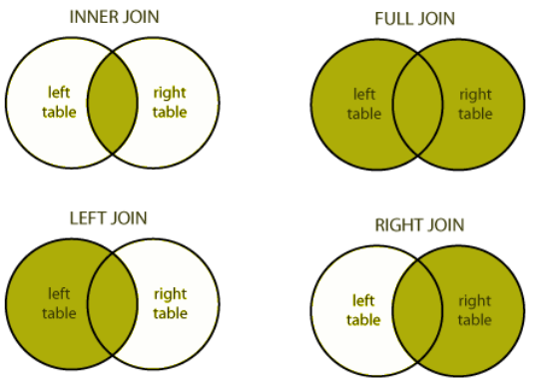

Slide 45
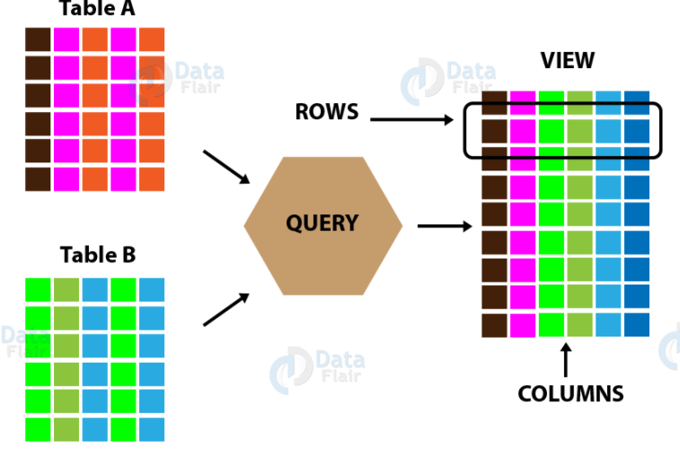

Slide 46
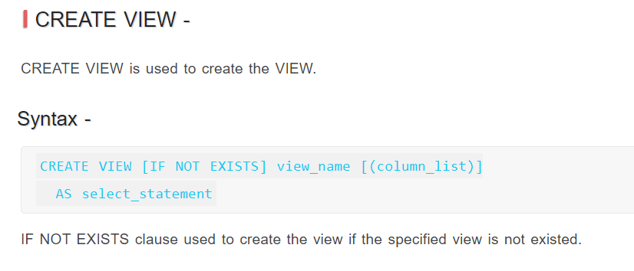
A view allows a query to be saved and treated like a table. It is a logical construct, as it does not store data like a table. In other words, materialized views are not currently supported by Hive.
When a query references a view, the information in its definition is combined with the rest of the query by Hive’s query planner. Logically, you can imagine that Hive executes the view and then uses the results in the rest of the query.
Create view
Alter view and drop view

Slide 47
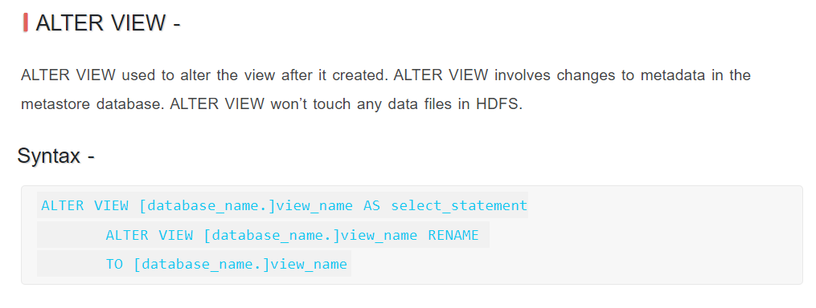
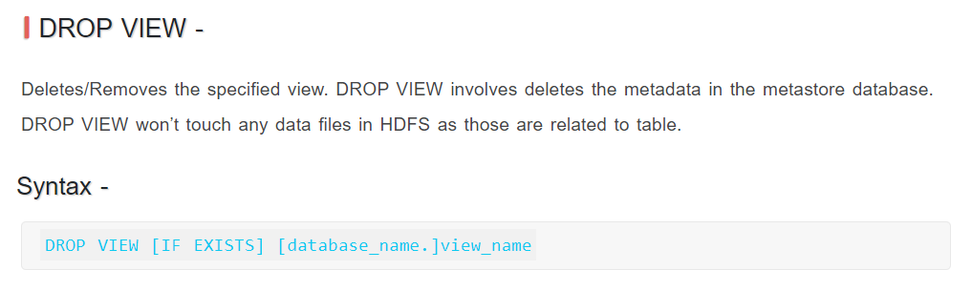

Slide 48
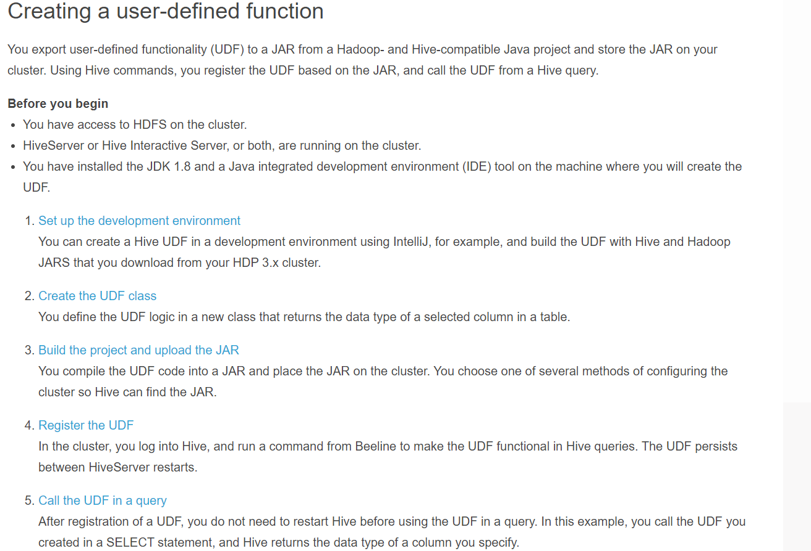

Slide 49
END OF SESSION
Q&A

